Slide 1
ARTS2U
ARTS2U is a feed of arts & culture events listings.
Information about arts events is gathered by automation into a structured database
Information is fed to media for display on their websites, and directly to arts audiences
This saves producers time and bypasses marketing intermediaries

Slide 2
Mandate at IETF
ARTS2U
Improve the discovery and circulation of arts events on the internet
Utilize events, arts genres, event types and associated media to inform the decision making
“Making the arts machine readable”

Slide 3
ARTS2U
The Problem
The arts sector publishes events in fragmented and disconnected ways
The possibility of using data to the sector’s advantage is not maximized
Data and metadata are silo-ed and not open across producer systems
Regrettably, intermediaries are the authorities of compiled arts data

Slide 4
ARTS2U
@IETF:
Step 1.
Preliminary Data organization
Step 2.
Construct widgets for user to indicate their interest in artists
Step 3.
Choice games are made to gauge user intent
User plays game 1 - Match game
User plays game 2 - Thumbs up Thumbs down
Results are logged in table identified by user

Slide 5
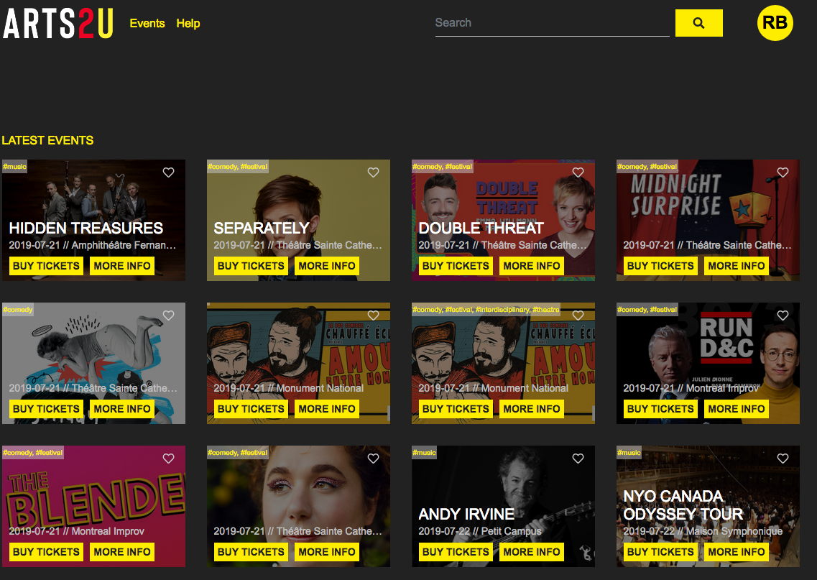
ARTS2U
Before:

Slide 6

ARTS2U
Gameplay:

Slide 7
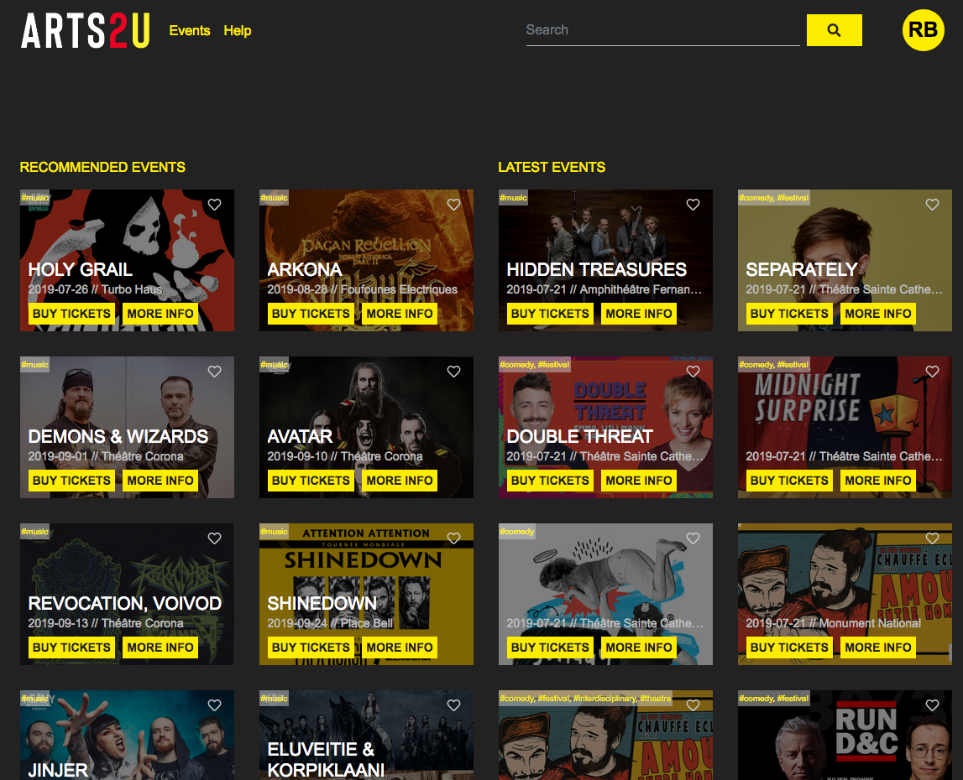
ARTS2U
After:

Slide 8
ARTS2U
Outcomes
We have begun organizing the system to tally user behavior based on gaming strategies. Much more organization needs to be complete before things can be modeled. Clearly the games can impact accuracy and show intent to further understanding of user interests. With ARTS2U’s continued focus on user behaviour, data structuring and events URI development, the visibility of arts events can be increased.
Forward Discussions
Much more data needs to be generated before any impactful modeling and testing can be done
Weighting has to be done based on user test results
Testing of user reactions to the game
Further Questions
How to implement secondary descriptive tags / keywords / descriptors and their value?
What about Event Types vs Master Genres?

